Slide 1




The Affect of Covid-19 on Low Income Communities
October 1, 2020

Slide 2



Project Presenters
Jazlyn Mazick
Michael Rivera
Niguel Williams

Slide 3
Project Proposal

Slide 4
Hypothesis
null: COVID-19 has no impact on low-income communities
COVID-19 has an impact on low-income communities

Slide 5
Focus of Analysis
What was the effect of Covid-19 on low-income communities vs. the rest of the targeted population?
Was there any effect on unemployment claims during the Covid-19 Pandemic?
How did COVID-19 affect different types of urbanization categories?

Slide 6
Sources
Covid-19 Dataset (County Level Confirmed – Latest Overall Numbers)
https://data.world/associatedpress/johns-hopkins-coronavirus-case-tracker/workspace/file?filename=1_county_level_confirmed_cases.csv
Covid-19 Dataset (County Level Cases & Deaths Timeseries)
https://data.world/associatedpress/johns-hopkins-coronavirus-case-tracker/workspace/file?filename=2_cases_and_deaths_by_county_timeseries.csv
Texas Counties: Median Household Income
https://txcip.org/tac/census/morecountyinfo.php?MORE=1013
Texas Weekly Claims by County
https://www.twc.texas.gov/files/agency/weekly-claims-by-county-twc.xlsx

Slide 7
Definitions
NCHS Urban-Rural Classification
Above Low-income household
Low-income household
Very Low-income household

Slide 8
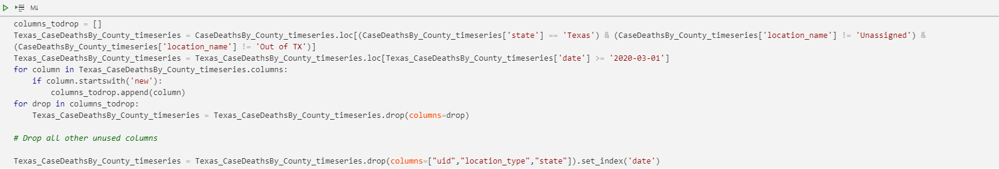
Data Cleansing
Looping through to remove unused columns
Selecting all rows based on end of month date
Cleaning and Transforming
Filtering dataset by State
Dealing with NaN and empty data

Slide 9
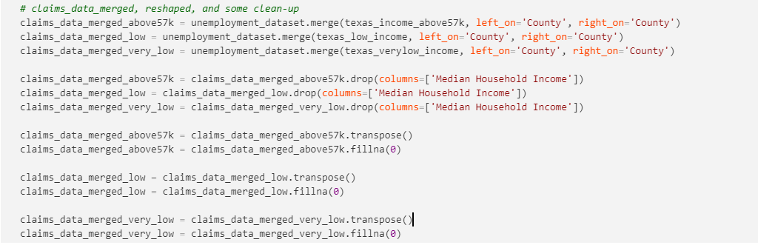
Data Exploration and Wrangling
Divide and Conquer(Creating categorical DataFrames)
Structuring the data
Transposing, Sorting, Grouping

Slide 10
Data Analysis - Unemployment and Covid-19
More unemployment claims for the above low-income counties
Spike in April
Unemployment claims fall for one group and rise for another over time

Slide 11
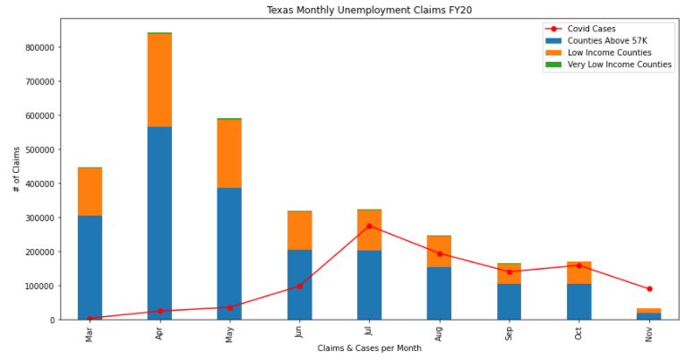
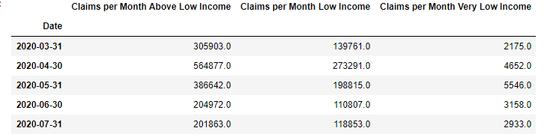
Data Analysis - Unemployment and Covid-19
DataFrame View of Data

Slide 12
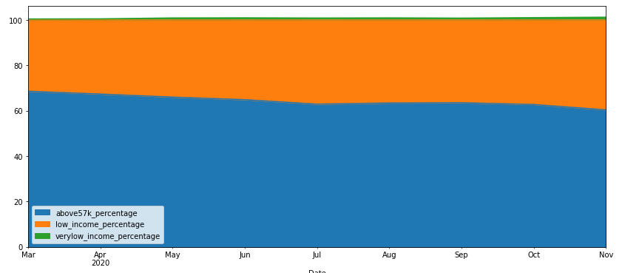
Data Analysis – Unemployment Claims by County Category

Slide 13
Data Analysis – Income Categories and Covid-19
Low-income communities had the highest prevalence of COVID-19
COVID cases spiked in July
Income categories and unemployment claims
Very low-income communities had the least reported cases of COVID-19

Slide 14
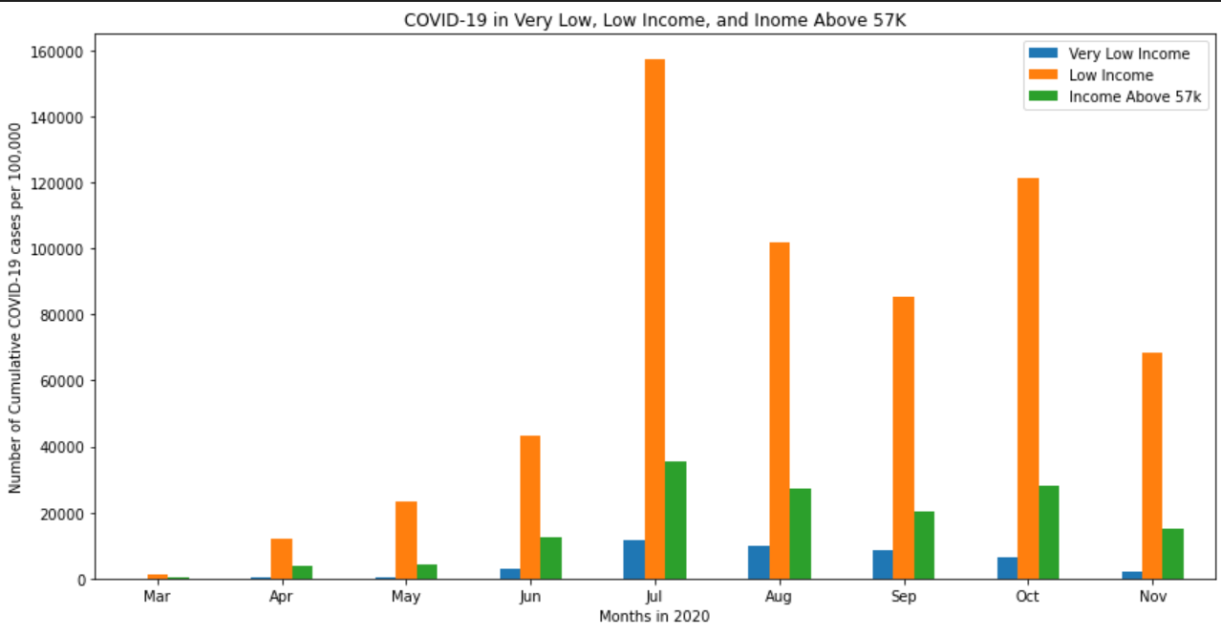
Data Analysis – Income Categories and COVID-19
Notes:
Pertaining to our question of how did covid-19 affect low income communities
We separated 254 counties in Texas by income category. *see definitions* this visualization shows that counties with primarily low income communities had the highest cumulative reported cases of covid-19 per 100,000. there are a multitude of factors that contribute to

Slide 15
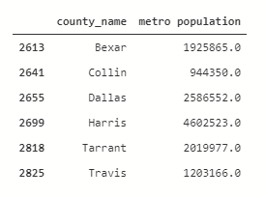
COVID-19 in Urban-Rural areas
Why focus on NCHS Urban-Rural Classification?
What areas are affected the most?
Where are we seeing the affects of COVID
Let’s talk about correlation

Slide 16
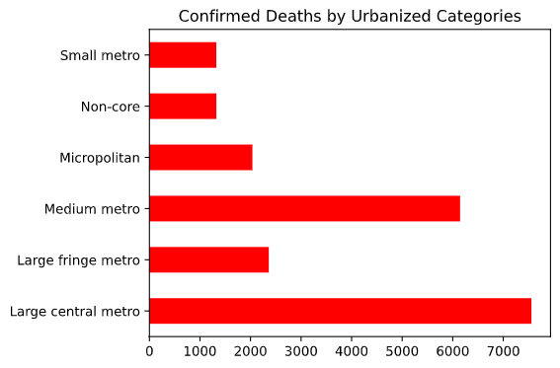
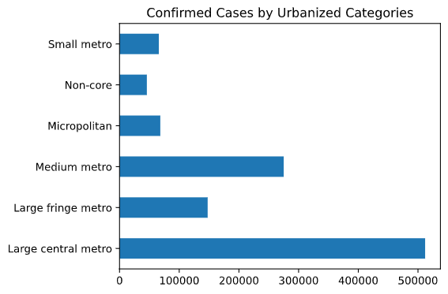
NCHS Urban-Rural Classification Covid-19 Cases and Deaths

Slide 17
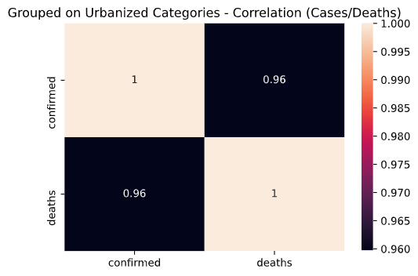

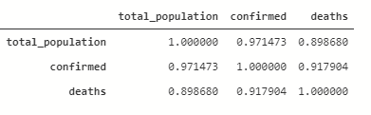
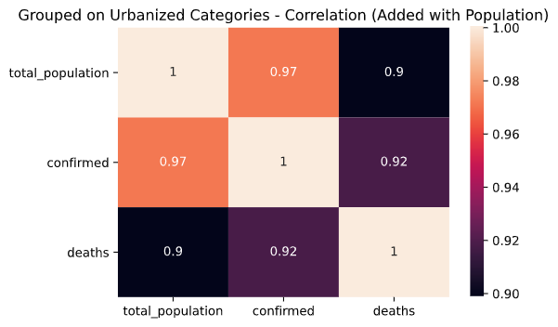

Slide 18
Post Mortem
Creating loops to deal with dates in a timeseries
Merging incorrectly can affect numerical outcome
Transposing creates other issues (Requires additional attention)
GitHub Operations

Slide 19
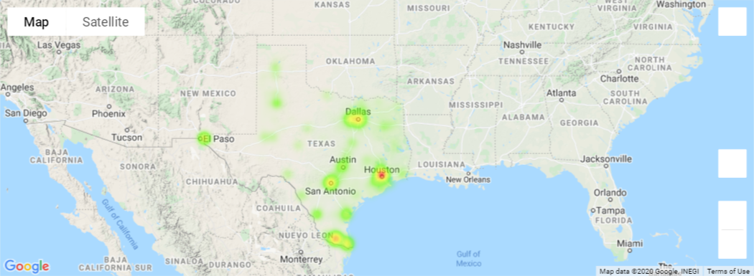
Covid-19 Deaths

Slide 20
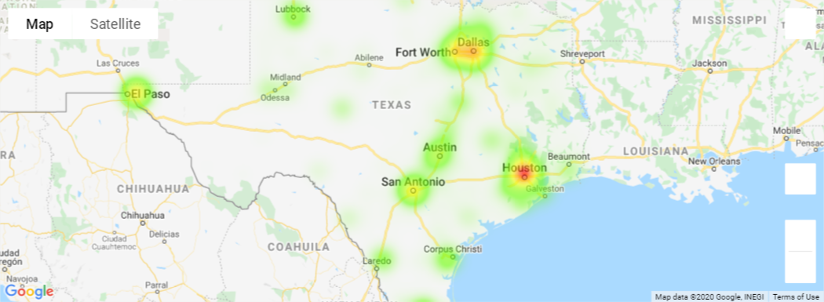
Covid-19 Cases

Slide 21
Questions?

